Slide 1
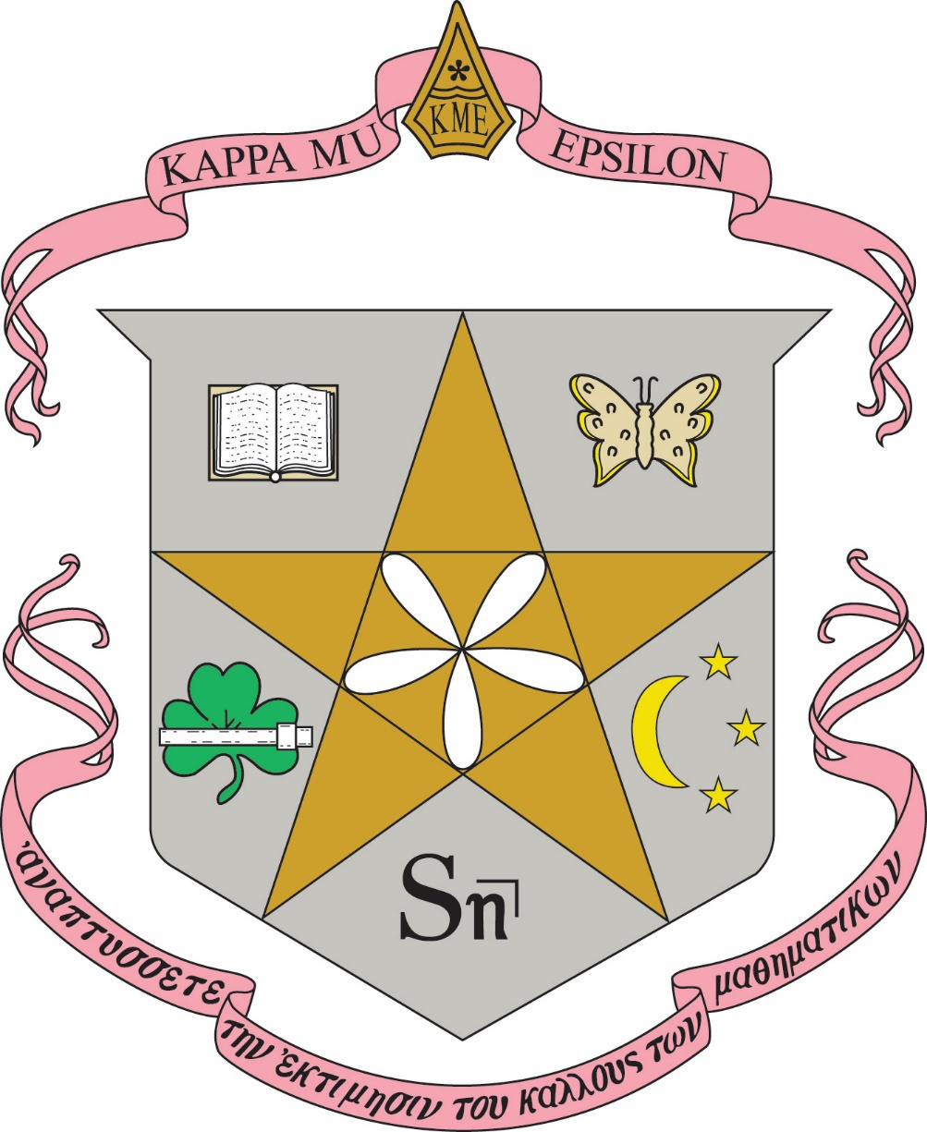
Kappa Mu Epsilon

Slide 2
History and Ideals
Kappa Mu Epsilon is a national organization founded in 1931 to promote the interest of mathematics among undergraduate students. We, the members, recognize the great service of mathematics in the development of civilization. Advancements continue to be made in the physical universe and in the sciences of human relationships by the application of mathematical knowledge. Mathematics as a pure science and art represents the height of intellectual endeavor.

Slide 3
History and Ideals
From the time of the Pythagoreans, mathematicians have derived inspiration and strength from working together. History records the activities of many scholarly societies devoted to mathematical research and discussion. Most of these groups have limited their memberships to students possessing advanced training in mathematics. Kappa Mu Epsilon, however, is a society for undergraduate students, as well as beginning graduate students and faculty, who have a strong commitment to mathematics. It is our belief that the advancement of mathematics depends upon individuals such as you who are being initiated here today.

Slide 4
The Purposes of KME
All civilizations have depended upon mathematics. Philosophers and logicians have recognized and used its power to develop systems of logic and thought. In addition to the natural sciences, mathematics has had an impact on art, economics, political science, religion, and other social sciences. Mathematics also has aesthetic beauty; the geometer and applied mathematician study and appreciate the harmonious relationships which exist between mathematics and the world around us. Because those interested in other fields of knowledge have recognized its worth, mathematics is often called "The Queen of The Sciences."

Slide 5
The Purposes of KME
The primary purposes of being a member of Kappa Mu Epsilon include the following:
to further interest in mathematics,
to emphasize the role of mathematics in the development of civilization,
to develop an appreciation of the power and the beauty of mathematics,
to recognize the outstanding mathematical achievement of its members, and
to familiarize members with the advancements being made in mathematics.

Slide 6
The Purposes of KME
Furthermore, Kappa Mu Epsilon strives to maintain a spirit of collegiality among men and women interested in mathematics. Friendship, cooperative enterprise, and willing service are essential in this relationship.
In brief, Kappa Mu Epsilon aspires to help you, as you will help others, to maintain a lasting interest in mathematics and its many contributions to society.

Slide 7
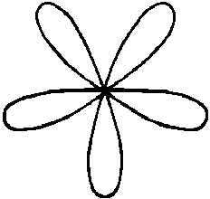
The name of this organization is Kappa Mu Epsilon National Mathematics Honor Society
The seal is a five pointed star, enclosing the five-leaf rose, and encircled by the legend, "Kappa Mu Epsilon, Founded 1931.
KAPPA MU EPSILON
FOUNDED 1931

Slide 8
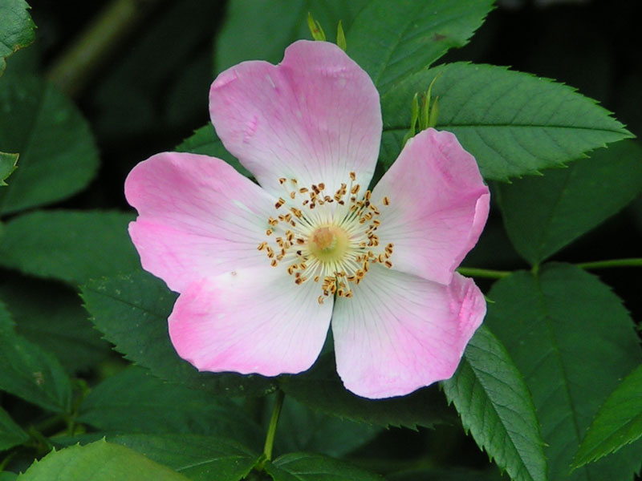
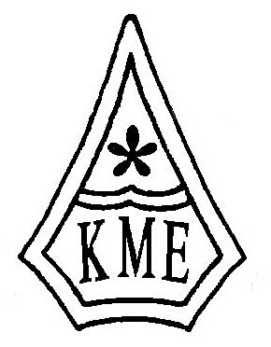
The flower is the wild rose;
The badge of the Society is a pentagon with the sides slightly concave. In the upper half is the five-leaf rose; in the lower half are the Greek letters Kappa Mu Epsilon.
the colors are rose-pink and silver.

Slide 9
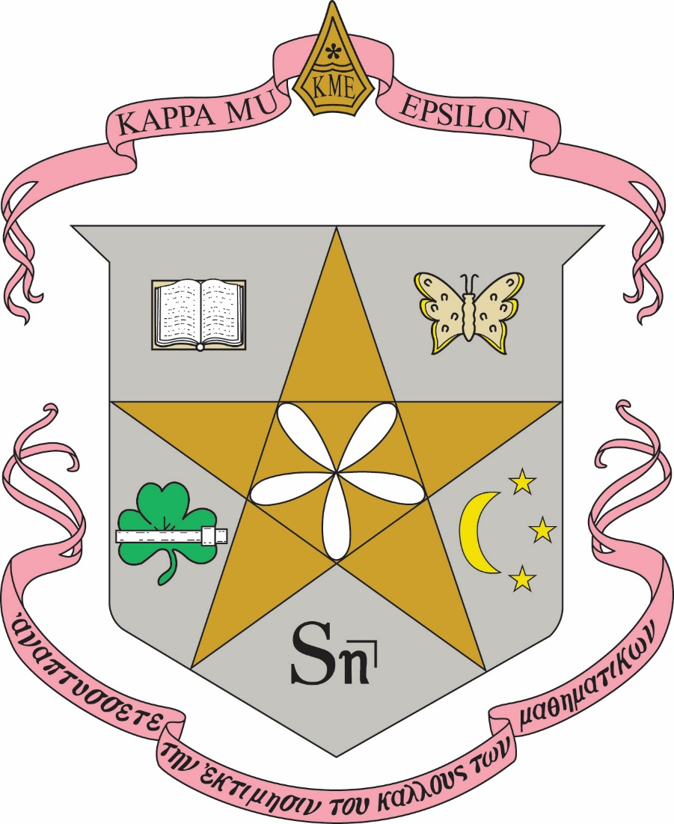
KME Crest
The crest is a shield enclosing the five-pointed star.
In the star is the graph of the rose, ρ = a sin 5θ, which represents pure mathematics.
Around the star are symbols indicative of the many areas using and influencing mathematics.
At the upper right is a butterfly, for the life sciences;
at the lower right is a moon with three stars, for the physical sciences;
at the bottom is the symbol "S angle n", for business and economics;
at the lower left is a shamrock beneath a slide rule, for engineering;
at the upper left is the book of knowledge for the many other areas that rely on recorded mathematical truths.
Above the shield is the design of the badge of the society.
Below the shield is a streamer upon which is printed in Greek the Kappa Mu Epsilon motto, which may be translated: "Develop an appreciation for the beauty in mathematics."

Slide 10
Kappa Mu Epsilon

